Slide 1
Investor securities disputes
ARBITRATION & LITIGATION
Representing those with portfolios mismanaged by brokers, broker-dealers, investment advisors or insurance advisors.

Slide 2
GAIL E. BOLIVER
Background
Graduated with a law degree from Creighton University in 1979. MBA from Arizona State University in 1976 and received a Bachelors Degree from Iowa State University (1971) a Masters Degree in Political Science from Iowa State University (2001).
A member and past board member of the Public Investors Arbitration Bar Association (PIABA). A member of the Iowa Association for Justice, the Iowa State Bar Association, the Nebraska Bar Association, the Omaha Bar Association, the Marshall County Bar Association, the Arizona State Bar Association, Arizona Association for Justice, Maricopa County Bar Association, East Valley (AZ) Bar Association and the American Immigration Lawyers Association (AILA).
Was commissioned in the USAF in 1971 and completed pilot training in 1972. Was an instructor pilot from 1972 to 1975. Left active duty in 1976. Joined the Air Force Reserves in 1980 and retired from the Iowa National Guard in 1999

Slide 3
Securities regulation - retail
U.S. Securities and Exchange Commission (SEC)
Federal law & Disciplinary Cases
Financial Industry Regulatory Authority (FINRA)
f/k/a – nasd (1939-2007) – NYSE Merger – SRO (Self Regulatory Organization)
License Registered representatives (RR’s)
and Broker Dealers (BD)

Slide 4
Investment advice -retail
2 major platforms:
Registered Representatives (RR) [Series 7, 63; others]
Stockbrokers/financial advisors, account representatives, etc.
Broker Dealers – Morgan Stanley, Merrill Lynch…(CFP, CFA…)
Investment Advisors [Series 65]
Investment Advi Representative (IAR)
Firm’s – Registered Investment advisor (RIA)

Slide 5
Financial Industry Regulatory Authority (finra)
Purpose: Safeguard investing public against Fraud & Bad Practices
FINRA violations:
Churning (fraud)
Ponzi Scheme
Bad investment Advice
Elder abuse
Fraud (omissions)
Overconcentration
Unauthorized trading
Others
State Regulation
States: Arizona Corporation Commission
State Registered Investment Advisors

Slide 6
FINRA - KEY RULES (CUSTOMER PROTECTION)
Code of Arbitration Procedure (Customer v. Industry)
Governs Dispute Resolution Forum
Customer Rules – Basics
Forum Requirements:
Rule 12200 Agreement or Customer Requests
Rule 12206 “Eligibility Rule”
*Key Words…”occurrence or event”…
c) Rule 12213 – Hearing Location

Slide 7
Case specific Rules
Rule 12302 “Statement of Claims”
Rule 12303 “Answer”
Rule 12312 “Multiple Claimants”
Rule 1240 “List Selection”
Rule 12500 “Initial Pre-hearing conference”
Rule 12503/12504 “Motions/Motion to Dismiss”
Rule 12506 “Discovery”
Rule 12602 “Attendance”; Rule 12604
Rule 12800 “Small Claims”
Rule 12904 “Awards”

Slide 8
FINRA - website “for investors”
https://www.finra.org/investors#/
Investing Basics and more..
Investment Goals
Rules
Fees and Commissions
Asset Allocation and Diversification
Evaluating Performance

Slide 9

Asset Allocation and Diversification
https://www.finra.org/investors/investing/investing-basics
https://www.finra.org/investors/investing/investing-basics/asset-allocation-diversification

Slide 10
Fees – commission or percent a.u.m. – Commission – Charge Or Fee Per Transaction (Buy Or Sell) Percent A.U.M.
1
Commission – purchase $100,000 – Stock 5% = $5,000
2
Percent A.U.M. – over time $100,000 – 1% = $1,000
3
5 years – 1. = $5,000; 2. if stocks moves up to $150,000 = 1% per year 1,000 x 4 = 4,000
1,500 x 1 = 1,500
$5,500
4
Buy and hold – commission. Trader – A.U.M. (annuities broker book; reduces churning);
Claim – “same side as customer”.

Slide 11
Finra – standards for brokers
Rule 2310 – Suitablity
Rule 2111 – Amended July 9, 2012
S.E.C. Regulation B.I. (Best Interest – June 30, 2020)
Rule 3110 BD Supervision
FINRA additional standards/guidance.
Notices (f/k/a)– Notice to Members – NTMs
Now- Regulatory Notices (RN’s)
Reminders, or change of standards or other

Slide 12
Investment Advisor Representative (IAR) and registered investment advisor (RIA)
Not FINRA (unless dually registered)
Contract Language – Dispute Resolution S.E.C. Registered – Study June 27, 2023 – Report to congress – 60% arbitration clause.
Limiting Language: Hedge, Statute limitation, Venue, Etc.
Arbitration – What Platform?
AAA – Consumer or Commercial Rules
I.A.R./R.I.A. – Non-payment
AAA- Process – Form – Contract - Claim

Slide 13
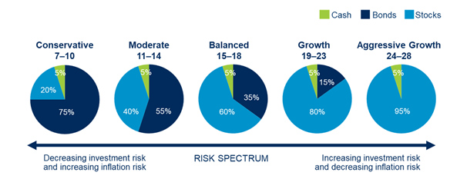
Sample Case - Portfolio

Slide 14

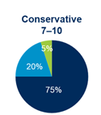
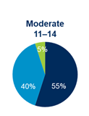
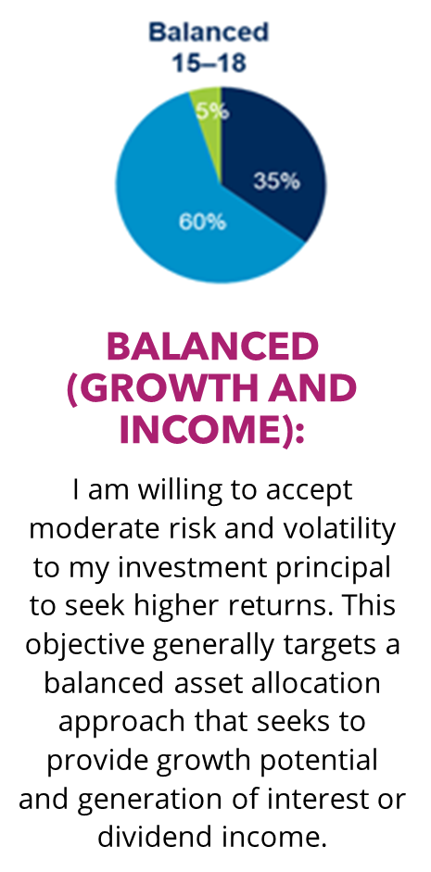
continued
Conservative (Income with Limited Growth):
Moderate (Income with Moderate Growth):
I am willing to accept relatively low risk to my investment principal and will tolerate some volatility to seek a modest level of income and/or objective returns. This objective generally focuses on asset appreciation sufficient to offset inflation over time while also generating current income.
I am willing to accept limited risk to my investment principal in this account, even if that means this account does not generate significant returns and may not keep pace with inflation. This objective generally focuses on the generation of current income.

Slide 15
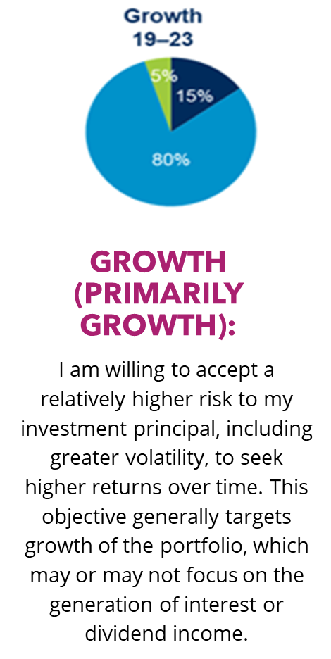
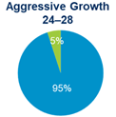
continued
Aggressive Growth (Growth):
I am willing to accept maximum risk to my initial principal in order to aggressively seek maximum returns. This objective generally seeks maximum growth potential or generation of income from equities or alternative investments.

Slide 16
continued
Generally, among asset classes, stocks may present more short-term risk and volatility than bonds or short-term instruments but may provide greater potential return over the long term. Although bonds generally present less short-term risk and volatility than stocks, bonds contain interest rate risk (as interest rates rise, bond prices usually fall), default risk, and inflation risk. Foreign investments, especially those in emerging markets, involve greater risk and may offer greater potential return than U.S. investments. These target asset mixes are hypothetical models and illustrate certain examples of many combinations of investment allocations that can help an investor pursue his or her goals; these target asset mixes do not constitute investment advice under the Employee Retirement Income Security Act of 1974 (ERISA). You should choose your own investments based on your particular objectives and situation. Remember, you may change how your account is invested. Be sure to review your decisions periodically to ensure that they are still consistent with your goals. Education on investment alternatives and services does not generally constitute investment advice as defined under ERISA. Asset allocation does not ensure a profit or protect against loss. For illustrative purposes only.

Slide 17
Damages
Defense
Net out-of-pocket (NOP) – Cash (cash in and out; no “investment loss”)
Plaintiff
Well Managed Account (WMA) – Opportunity lost
Punitive Damages
Attorney Fees (via Arizona State Securities Act.)

Slide 18

PRODUCT – variable annuity
Securities product
Effectively “Mutual Funds Packaged in Insurance Wrapper”
Expensive Life Insurance fees
Commission: High
Surender fees – Typically 6-7 years…
Issues
“Twisting” (turnover/churning)
“Subaccount selections”
Product Strategy
Long term hold product

Slide 19
Sample cases
Churning (almost gone)
Unsuitable portfolio
Failure to Supervise
Negligence
Fraud
Breach of fiduciary duty

Slide 20
SUMMARY
Representing investors involves understanding the industry, rules and guidance and the arbitration process (if FINRA case).
If representing an investor against an investment advisor, the contract for advice must be reviewed. The contract could designate arbitration (AAA or other) or no designation (so court).
The arbitration process can be faster and may be more efficient but neither are guaranteed. Discovery can be as challenging as court (despite FINRA guidance on discovery)
Questions?

Slide 21

Gail E. Boliver
602-448-8427
boliver@boliverlaw.com
www.boliverlaw.com

